Slide 1

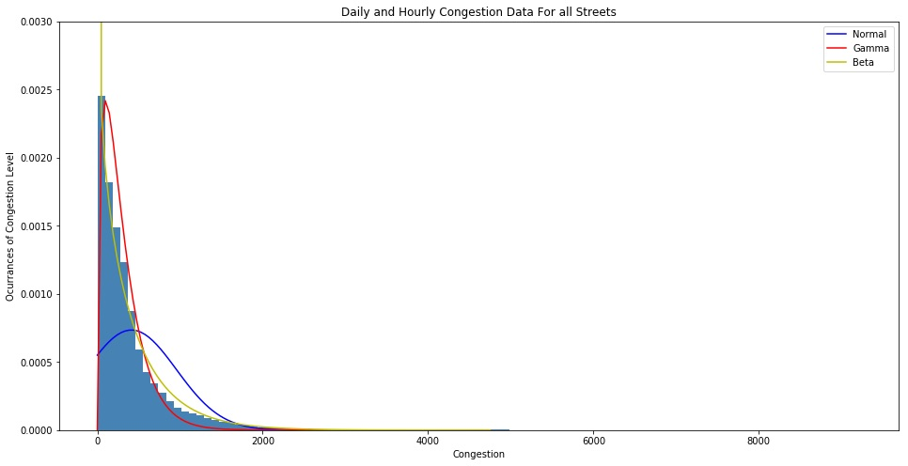
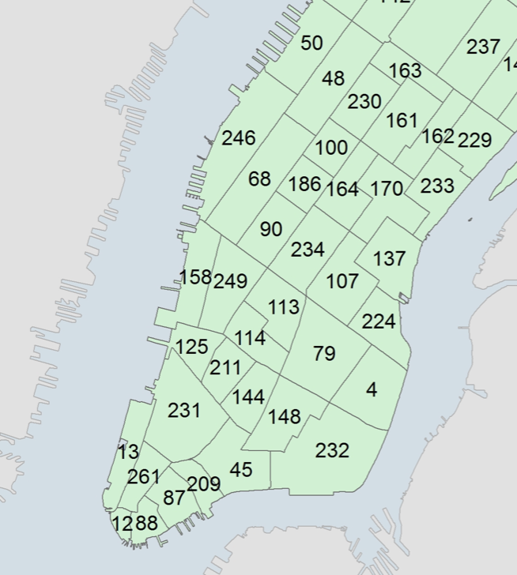
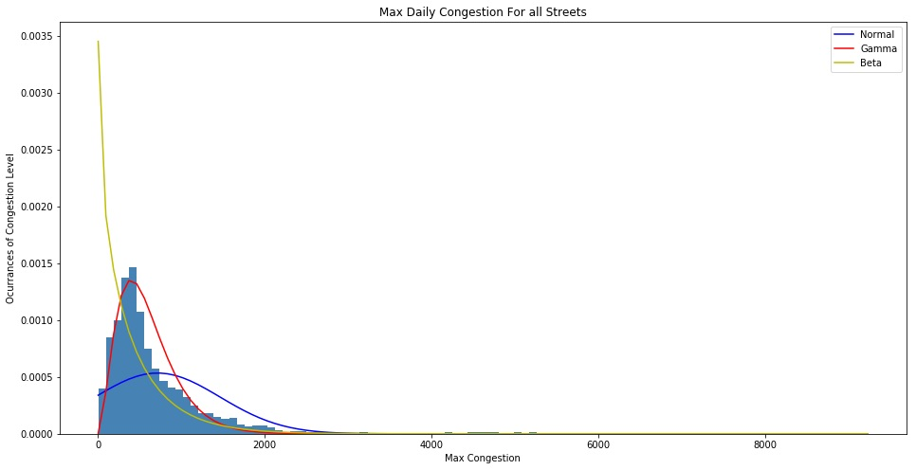
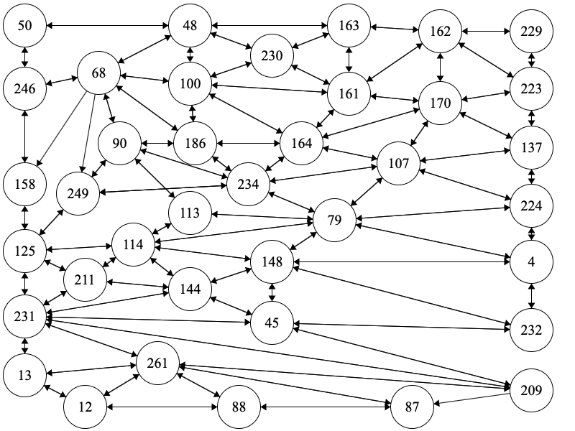



A Game Theoretic Approach to New York City Congestion Pricing
Harvard University
Tech Science to Save the World
GOV 1430
Nathan Ondracek, Ali Dastjerdi
nondracek@college.harvard.edu
ABSTRACT
METHODS
RESULTS
CONCLUSIONS
NYC is trying to tackle its problem of traffic using congestion pricing. This paper proposes using the game theoretic model of congestion games to model and understand an optimal pricing strategy for NYC congestion. Our model suggests that congestions pricing does not necessarily need to be onerous enough to discourage drivers from using cars to reduce traffic, but rather can incentivize traffic routes that are socially optimal, reducing overall traffic.
The methods for the preliminary data exploration and distribution analysis:
Plot street congestion data to find the distribution of street congestion by time, street, and max congestion.
Fit and plot normal, gamma, and beta pricing model distributions over the data to see how many streets would be overpopulated or underpopulated with each pricing distribution.
The following steps were taken to create a congestion model of lower Manhattan
The map of New York City Taxi zones was translated into a network representing all paths from one taxi zone to another, weekdays between rush hour times (4PM-7PM).
Each grouped starting and ending zone data was made into an “agent” in the congestion model, and agents were designated to always take the fastest route (least distance weighted by congestion). After each agent takes a route, they add their congestion into the model.
This entire process was repeated 100 times and average congestion values was recorded.
Based on our preliminary data exploration, we are confronted by the problem we expected: primarily low volume streets with a tail of high traffic streets. Further, we see clear effects of rush hour with peaks in the morning as people get to work and in the afternoon as people leave work.
As we look at the distribution of all congestion data for all streets and all times, we see a very pronounced right skew, the majority of data is centered towards smaller congestion values. As you can see in the figure below, we fit normal, gamma, and beta distributions to the data to test common pricing models:
We then looked at the distribution of the most congested time of day for each street, hoping to prune out low traffic times that would not need as strict of a pricing model. In the figure below, we again fit normal, gamma, and beta distributions to the data to visualize common pricing models:
Based on the error above, the beta pricing distribution best fit the current congestion data for all times and streets in our data. Intuitively, this makes sense as a beta distribution best fits a highly exaggerated skew; however, the error was still remarkably high at 99%.
We can see that the gamma pricing model best fit the current congestion data for max traffic times for each street in our data. This also makes sense as the gamma distribution fits a moderate skew without starting from infinity at zero.
Our analysis of different pricing models for NYC’s congestion pricing plan show various tradeoffs in how congestion pricing could be implemented. Different distributions capture very different amounts of the underlying distribution of the data. Although some distributions have lower error rates, like the gamma distributions, others better model the tails of the distribution like the beta model.
INTRODUCTION
NEXT STEPS
NYC is the third most congested city in the world, with New Yorkers spending 13% of their days stuck in traffic [5]. This level of congestion has lead New York City lawmakers to a novel solution to the problem – congestion pricing. Governor Andrew Cuomo’s budget proposal, which has been approved by state lawmakers, includes a congestion tax for travelers in the lower Manhattan area [1]. This proposal would make New York City the country’s first city to use congestion pricing, and would undoubtedly change the face of the nation’s largest city [2].
In its current state, the proposal passed by lawmakers includes very few details on how the congestion pricing would work [2]. A group of experts are set to be tasked with hammering out the details of where and when congestion pricing will occur and how much the pricing of the tax will be. The goal of this paper will be to inform those questions using a game theoretic approach. The problem of traffic congestion can be simplified into a common class of game theory models referred to as congestion games [3]. This model shows that when every driver acts in their own best interest in taking the fastest route, socially optimal routes, which reduce total travel times, are not taken [3]. The model also shows that changing incentives in the game by for example adding a cost to certain routes results in lowering total travel times [3].
A congestion pricing model for NYC will have a major impact on the city and the likelihood that this model is adopted by other cities. Our work here seeks to make NYC congestion pricing as effective as possible in order to allow the new policy to meet its goals.
Next steps in the project will be to use to model for understanding equilibrium congestion in NYC to understand what changes can be made to result in an equilibrium model that is socially optimal. Congestion games result in equilibrium, meaning states in which no agent can achieve a better outcome, that are socially suboptimal, meaning that total travel times in the system can be reduced. To understand how a new equilibrium can be achieved in the congestion model that is socially superior, we will work to build a Q-learning model that iteratively makes certain routes more or less costly in order to reduce overall travel times. The goal of our final model will be to show that subtle congestion pricing can reduce traffic without reducing the number of cars on the road by incentivizing socially optimal traffic routes.
REFERENCES
Hajela, D. (2019, April 03). NYC 1st in US With Congestion Pricing -- How Does It Work? Retrieved April 23, 2019, from https://www.nbcnewyork.com/news/local/Congestion-Pricing-NYC-Details-508046911.html
Hu, W. (2019, March 27). Over $10 to Drive in Manhattan? What We Know About the Congestion Pricing Plan. Retrieved April 23, 2019, from https://www.nytimes.com/2019/03/26/nyregion/what-is-congestion-pricing.html
Rosenthal, R. W. (1973). A class of games possessing pure-strategy Nash equilibria. International Journal of Game Theory,2(1), 65-67. doi:10.1007/bf01737559
Schneider, T. (n.d.). Analyzing 1.1 Billion NYC Taxi and Uber Trips, with a Vengeance. Retrieved April 23, 2019, from https://toddwschneider.com/posts/analyzing-1-1-billion-nyc-taxi-and-uber-trips-with-a-vengeance/
Walker, A. (2018, February 06). New York drivers spent an average of 91 hours in traffic last year. Retrieved April 23, 2019, from https://ny.curbed.com/2018/2/6/16979696/new-york-city-traffic-congestion-second-worst
Harvard University
Department of Government

